Slide 1
FISWG
NISPOM Basics
What You Need to Know!
Orlando, Florida
July 20, 2016
Chris Deshotel
Facility Security Officer

Slide 2
Overview
The purpose of this briefing is to provide a quick “what you need to know,” chapter by chapter review of the NISPOM for new Facility Security Officers (FSOs) and Alternate FSO’s as well as Security personnel who may have secondary security responsibilities.
Due to the allotted time and the necessity to cover chapters properly, the below chapters will not be covered:
Chapter 4: Classification and Marking
Chapter 6: Visits and Meetings
Chapter 7: Subcontracting
Chapter 8: Information System Security
SAP and SCI will not be covered.

Slide 3
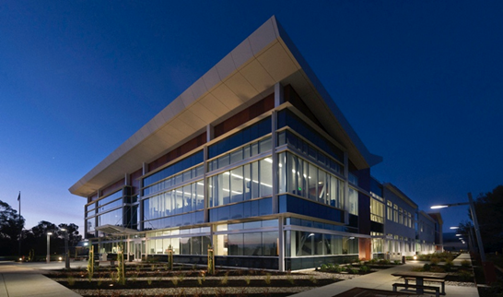
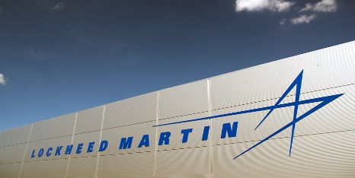
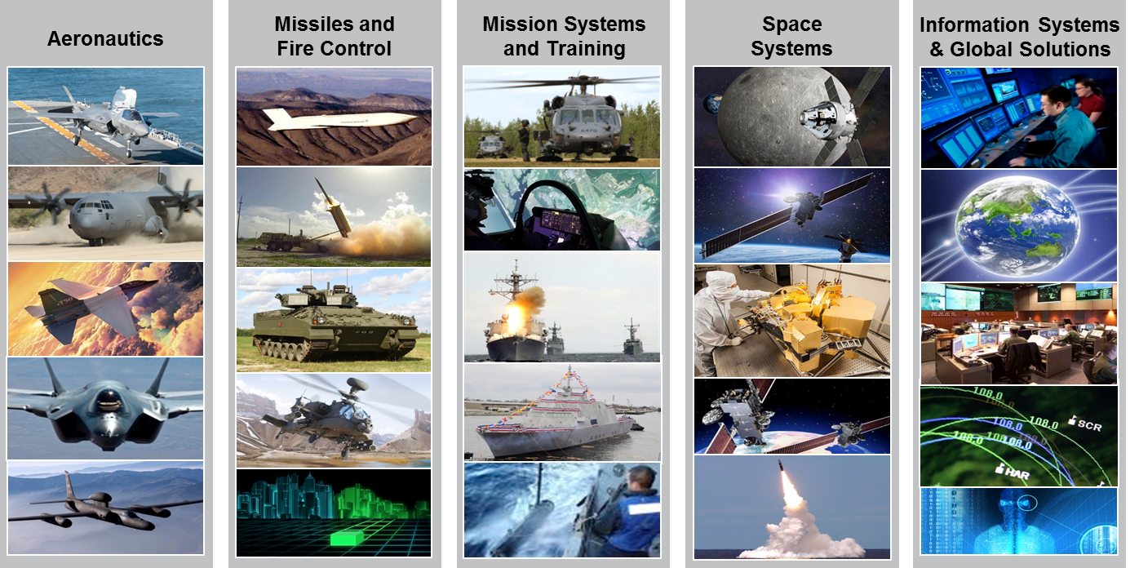
Lockheed Martin Overview
125,000 Employees
Operating in over 70 Countries
and 590+ Facilities
135 Cleared Facilities
33 AA, A, B 102 C, D, E

Slide 4
Chapter 1
General Provisions and Requirements

Slide 5
General Provisions & Requirements
1-206b - Contractor Reviews:
“Contractors shall review their security system on a continuing basis and shall also conduct a formal self-inspection at intervals consistent with risk management principles”:
Conforming Changes 2 (1-207b) requires an annual self-inspection that is certified by senior management
Use the DSS Self-Inspections Checklist located on the DSS website
Self-inspection report(s) must be made available during your DSS inspection
Work with your DSS Representative on how/if they would like the findings reported:
Provide checklist
Presentation style

Slide 6
General Provisions & Requirements
1-302 - Reports to be Submitted to the CSA:
What should be reported?
1-302a: Adverse Information:
Only Adverse reports that are confirmed should be submitted
JPAS Selections:
1-302b: Suspicious Contact Reports (SCR’s):
“Contractors shall report efforts by any individual, regardless of nationality, to obtain illegal or unauthorized access to classified information or to compromise a cleared employee.”
Allegiance to the United States | Financial Considerations | Handling Protected Information
Foreign Influence | Alcohol Consumption | Outside Activities
Foreign Preference | Drug Involvement | Use of Information Technology Systems
Sexual Behavior | Psychological Conditions
Personal Conduct | Criminal Conduct

Slide 7
General Provisions & Requirements
1-302 - Reports to be Submitted to the CSA (cont.):
What should be reported?
1-302c: Change in Cleared Employee Status:
Death, name change, termination, change in citizenship, change in the requirement to access classified
KMP Changes
1-303 - Reports of Loss, Compromised, or Suspected Compromise:
Process for violation:
Report directly to the CSA
Presume lost until an investigation determines otherwise

Slide 8
Chapter 2
Security Clearances

Slide 9
Security Clearances
General
Facility Security Clearances vs. Personnel Security Clearances
FCL
2-100: Administrative determination that a company is eligible for access to classified information or contract
PCL
2-102: Contractor cannot apply for its own FCL – GSA or another cleared contractor may sponsor you for an FCL
2-109: Parent-Subsidiary Relationships – two Different entities, two different DD 254s
2-104: PCLs Required in connection w/FCL. KMP’s = A Senior Management rep. and FSO must always be cleared to the FCL level
2-200b: Cognizant Security Agency (CSA) Database = JPAS. Contractors are responsible for ensuring the system of record (JPAS) is accurate
Should you maintain a separate database to track your records, it should be compared regularly and frequently
JPAS:
It is prohibited to printout JPAS screens
Verify KMP Designation
Consultants: Requires a contract with a person, not a company.

Slide 10
Security Clearances
2-201d - Reinvestigation:
Periodic Reinvestigation’s must be submitted by the investigation date, not the adjudication!
2-202a - SF-86 review by FSO:
Notification must be made to the employee that the FSO (or designee) will review the SF-86 for completeness and accuracy
2-202b - SF-86 Retention:
SF-86’s may only be retained during the clearance process. Once eligibility has been granted or denied, the retained documentation must be destroyed
2-208 - Acceptable Proof of Citizenship:
I-9’s are not acceptable proof of citizenship

Slide 11
Security Clearances
2-212 - Consultants:
Who is a consultant?
A non-employee who requires access to classified and is under contract to provide professional or technical assistance:
Remember, consultants are paid directly, sub’s are paid company wide
What do you need?
A signed Consultant agreement
What you need to remember:
Initial security briefing
Annual refresher briefing
Keep the documentation
JPAS Category:
Under the Category area in JPAS, it should be “Industry (Consultant) cage code

Slide 12
Chapter 3
Security Training and Briefings

Slide 13
Security Training and Briefings
3-102 - FSO Training:
What FSO training is required?
FSO Program Management for Possessing Facilities:
This will take some time, don’t wait
If you are an AFSO and have been in that positon for more than one year, you must complete the course
3-105 - Classified Information Nondisclosure Agreement (SF-312):
Do not forget to mail the form to PSMO
Process is located on the FISWG website
3-106/3-107 - Initial Security Briefings / Refresher Training:
Provide briefing PRIOR to employee gaining access to classified
Must contain: Threat Awareness, Defensive Security, Security Classification Overview, Reporting Obligations & Requirements and Security Procedures & Duties pertaining to job responsibilities
Refresher training is required annually

Slide 14
Security Training and Briefings
3-108 - Debriefings:
Offsite Briefings:
It is permissible to mail the debriefing to the employee

Slide 15
Chapter 5
Safeguarding Classified Information

Slide 16
Safeguarding Classified Information
5-102 - End of the Day Security Checks:
Is the classified secured?
5-103a - Subject to Inspection:
Post your signs at your entry & exits
5-103b - Searches:
Use random sampling technique
Consult your legal department

Slide 17
Safeguarding Classified Information
5-200 (ISL 2006-01 #9 (5-200) - Information Management System:
Utilize a system to track Secret and Confidential information:
Commercial Off The Shelf (COTS) product
Excel spreadsheet
Where is your classified?
You must be able to provide DSS with the What, When, and How:
Example: Your systems says document “A” is here, where is it and what happened to it?
5-202 - Receiving Classified Material:
Signed for by “authorized persons”
Make sure your P.O. Box is current (not expired):
Make it a point to check your P.O. Box twice monthly
Make sure your Couriers carry a Courier Card and are properly trained

Slide 18
Safeguarding Classified Information
5-308 - Protection of Combinations to Security Containers, Cabinets, Vaults, and Closed Areas:
5-308a: Access:
Access is kept to a minimum
Access lists must be maintained
If someone is listed as having access, they must be aware of the combination
5-308c: Combinations:
Combinations shall be safeguarded in accordance with the highest classification of the stored material
5-308d: Combination Records:
Marked as the highest level and kept in a container at that level

Slide 19
Safeguarding Classified Information
5-309 - Changing Combinations:
5-309: Changed by persons authorized access to the contents of the container, or by the FSO or his/her designee
5-309a: Initial use
5-309b: Termination of employees (Change in Duties)
5-309c: Compromise or suspected compromise
5-309d: At the FSO’s discretion
COMSEC – Required every 2 years
5-900 - Intrusion Detection System:
5-902: Central Monitoring Station:
If you have guard services that respond to alarms in a classified area, they are required to have a DD-254

Slide 20
Chapter 8
Information System Security

Slide 21
Information Systems Security
AIS Auditing Overview January 2016

Slide 22
Chapter 9
Special Requirements

Slide 23
Special Requirements
9-405 - CRYPTO Access Briefing and Debriefing Requirements:
9-405e: SD 572 Debriefings must be kept for three years
9-407 - Subcontracting COMSEC Work:
Written approval from the GCA is required

Slide 24
Chapter 10
International Security Requirements

Slide 25
International Security Requirements
10-706 - NATO Briefings:
Maintain NATO debriefings for two years for NATO SECRET and CONFIDENTIAL and three years for COSMIC TOP SECRET
10-712b - NATO Combinations:
NATO Containers must be changed annually

Slide 26
Questions?

